Slide 1

Indiana State Library Statewide Remote Circulation Service Request for Service 20-003
Pre-Proposal Conference
June 18, 2019
12:00PM EST
Arthur L. Sample IV, Strategic Sourcing Analyst
Indiana Department of Administration

Slide 2
Agenda
General Information
Purpose of RFP
Key Dates
Proposal Preparation & Evaluation
Minority and Women’s Business Enterprises (M/WBE)
Indiana Veteran Owned Small Business (IVOSB)
Question and Answer Session
Indiana Department of Administration

Slide 3
General Information
Sign-In Sheet for Attendees
Sign-In Sheet and PowerPoint will be posted on IDOA’s Solicitation Website
Hold questions until the end of the presentation
Any verbal response is not considered binding; respondents are encouraged to submit any question formally in writing if it affects the proposal that will be submitted to the state.
Additionally, the State will only be answering RFP process-related questions (i.e. how to fill out IDOA forms, etc.). No scope of work questions will be addressed.
Indiana Department of Administration

Slide 4
Purpose of the RFP
Indiana Department of Administration

Slide 5
Term of RFP
The term of the contract shall be for a period of one (1) year from the date of contract execution. There may be three (3) one-year renewals for a total of four (4) years at the State’s option.
Indiana Department of Administration

Slide 6
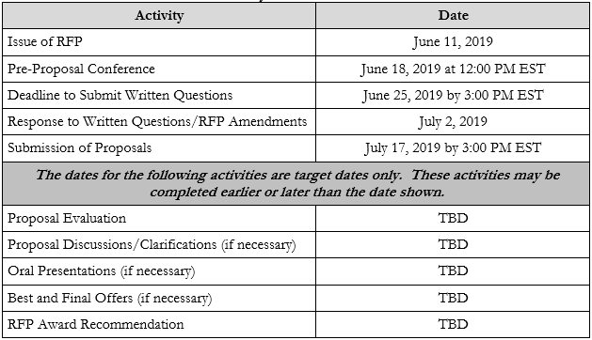
Key Dates
Indiana Department of Administration

Slide 7
Business Proposal (Attachment E)
Company Financial Information (Section 2.3.3)
Confidential information must be kept separate from the proposal in both hard and soft copy
Contract Terms (Section 2.3.5)
Respondent should review sample State contract and note exceptions to State mandatory and non-mandatory clauses in Transmittal Letter
Indiana Department of Administration

Slide 8
Technical Proposal (Attachment F)
Please use the Template we have provided for you.
Where appropriate, supporting documentation may be referenced by a page and paragraph number.
Indiana Department of Administration

Slide 9
Cost Proposal (Attachment D)
Cost scores will then be normalized to one another, based on the lowest cost proposal evaluated. The lowest cost proposal receives a total of 35 points. The normalization formula is as follows:
Respondent’s Cost Score = (Lowest Cost Proposal / Total Cost of Proposal) X 35
Indiana Department of Administration

Slide 10
Proposal Preparation
Buy Indiana (RFP Sections 2.3.14, 2.7)
Status shall be finalized by proposal due date
5 definitions, details provided in Business Proposal
Indiana Economic Impact (RFP Section 2.6, Attachment C)
Definition of FTE (Full-Time Equivalent)
Example: If a Respondent has 5 full time employees and is bidding on its 5th contract, and all contracts get an equal amount of commitment from the employees then each employee commits 20% of his or her time to the new contract:
0.2 x 5 employees= 1 FTE.
Indiana Department of Administration

Slide 11
Proposal Preparation
Attachment D (Cost Proposal) must be returned in Excel
Use the templates provided for all answers
Do not alter templates
Submit all questions using template provided
Indiana Department of Administration

Slide 12
Proposal Evaluation
Summary of Evaluation Criteria:
Criteria | Points
Adherence to Mandatory Requirements | Pass/Fail
Management Assessment/Quality (Business and Technical Proposal) | 40 available points
Cost (Cost Proposal) | 35 available points
Indiana Economic Impact | 5
Buy Indiana | 5
6. Minority Business Enterprise Subcontractor Commitment | 5 ( 1 bonus point is available, see Section 3.2.6)
7. Women Business Enterprise Subcontractor Commitment | 5 ( 1 bonus point is available, see Section 3.2.6)
8. Indiana Veteran Business Enterprises (IVOSB) | 5 ( 1 bonus point is available, see Section 3.2.7)
Total | 100 (103) if Bonus awarded
Indiana Department of Administration

Slide 13
Minority and Women’s Business Enterprises
Mission/Vision
Promote, monitor, and enforce the standards for certification of minority and women’s business enterprises.
Provide equal opportunity to minority and women enterprises in the state’s procurement and contracting process.
Nondiscrimination and Antidiscrimination Laws
Pursuant to Indiana Civil Rights Law, specifically IC §22-9-1-10, every state contract shall contain a provision requiring the contractor and subcontractors to not discriminate against any employee or applicant with respect to Protected Characteristics
Indiana Department of Administration

Slide 14
Minority and Women’s Business Enterprises
Contact Information
Phone: 317-232-3061
E-mail: mwbecompliance@idoa.in.gov
Web: www.in.gov/idoa/mwbe
Complete Attachment A, MWBE Form
- Include sub-contractor letter of commitment
Goals for Proposal
- 8% Minority Business Enterprise
- 8% Women’s Business Enterprise
Indiana Department of Administration

Slide 15
Minority and Women’s Business Enterprises
Prime contractors must ensure that the proposed subcontractors meet the following criteria:
Are listed in the IDOA Directory of Certified Firms, on or before the proposal due date, national diversity plans are generally not accepted. The directory can be found here: http://www.in.gov/idoa/mwbe/2743.htm
Serve a Valuable Scope Contribution (VSC) on the engagement, as confirmed by the State.
Provide the goods or services specific to the contract and within the industry area for which it is certified
Indiana Department of Administration

Slide 16
Minority and Women’s Business Enterprises
Prime contractors should note the following:
Subcontractors’ MBE/WBE Certification Letter, provided by IDOA, must accompany the proposal to show current status of certification.
Each firm may only serve as one classification – MBE, WBE, or IVOSB (see section 1.22)
Pursuant to 25 IAC 5-6-2(b)(d), a Prime Contractor who is a MBE or WBE must meet subcontractor goals by using other listed certified firms. Certified Prime Contractors cannot count their own workforce or companies to meet this requirement.
Indiana Department of Administration

Slide 17
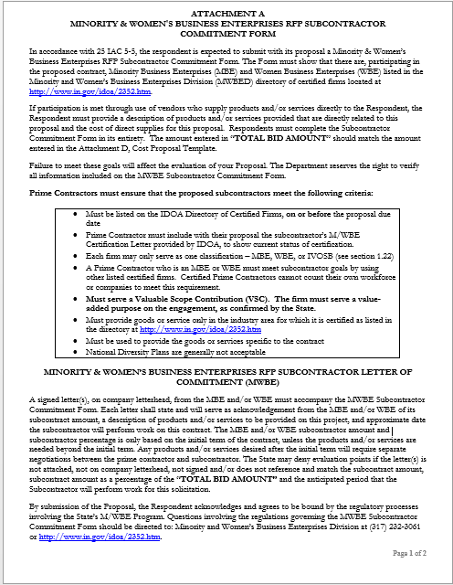
Indiana Department of Administration

Slide 18
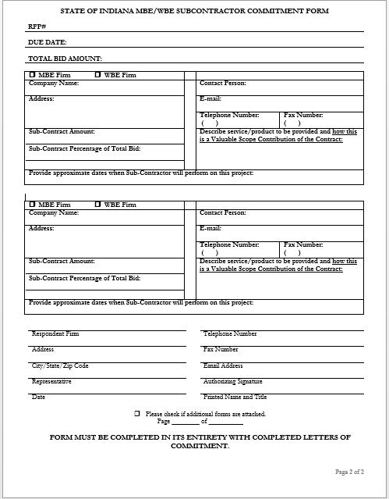
Indiana Department of Administration

Slide 19
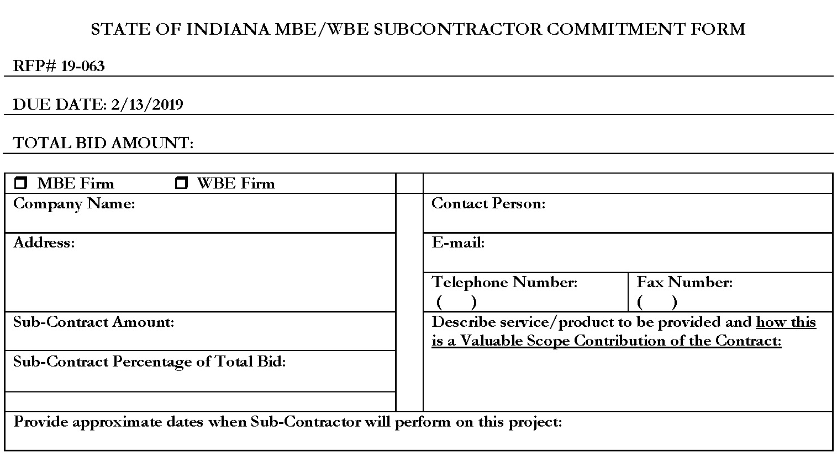
Minority and Women’s Business Enterprises
Indiana Department of Administration

Slide 20
Minority and Women’s Business Enterprises
New Process – Effective 2014, MWBE scoring is conducted based on 10 points plus a possible 2 bonus points scale
MBE: Possible 5 points + 1 bonus point
WBE: Possible 5 points + 1 bonus point
Professional Services Scoring Methodology:
The points will be awarded on the following schedule:
Fractional percentages will be rounded up or down to the nearest whole percentage
If the respondent’s commitment percentage is rounded down to 0% for MBE or WBE participation the respondent will receive 0 points.
Submissions of 0% participation will result in a deduction of 1 point in each category
The highest submission which exceeds the goal in each category will receive 6 points (5 points plus 1 bonus point). In case of a tie both firms will receive 6 points
% | 1% | 2% | 3% | 4% | 5% | 6% | 7% | 8%
Pts. | .625 | 1.25 | 1.875 | 2.5 | 3.125 | 3.75 | 4.375 | 5.0
Indiana Department of Administration

Slide 21
Indiana Veteran Owned Small Business
Contact Information
Phone: 317-232-3061
E-mail: Indianaveteranspreference@idoa.in.gov
Web: www.in.gov/idoa/2862.htm
Complete Attachment A1, IVOSB Form
Include sub-contractor letters of commitment
Goals for Proposal
3% Indiana Veteran Owned Small Business
Indiana Department of Administration

Slide 22
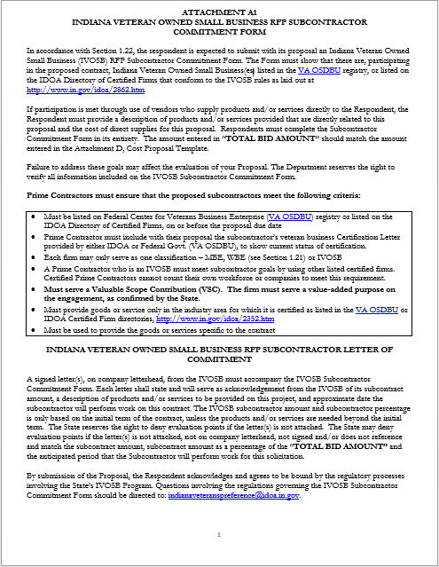

Slide 23
Indiana Veteran Owned Small Business
Prime contractors should note the following:
Pursuant to 25 IAC 9-4-1(c), a Prime Contractor who is an IVOSB can use their own workforce to count toward the goal.
IVOSB must have a Bidder ID (see section 2.3.7 - Department of Administration, Procurement Division).
Prime contractor and/or subcontractors’ Certification Letter(s), provided by IDOA or VA OSDBU, must accompany the proposal to show current status of certification.
Each firm may only serve as one classification – MBE, WBE, or IVOSB (see section 1.22).
Indiana Department of Administration

Slide 24
Indiana Veteran Owned Small Business
Prime contractors must ensure that the proposed subcontractors meet the following criteria:
Must be listed on Federal Center for Veterans Business Enterprise (VA OSDBU) registry or listed on the IDOA Directory of Certified Firms, on or before the proposal due date.
Serve a Valuable Scope Contribution (VSC) on the engagement, as confirmed by the State.
Provide the goods or services specific to the contract and within the industry area for which it is certified
Indiana Department of Administration

Slide 25
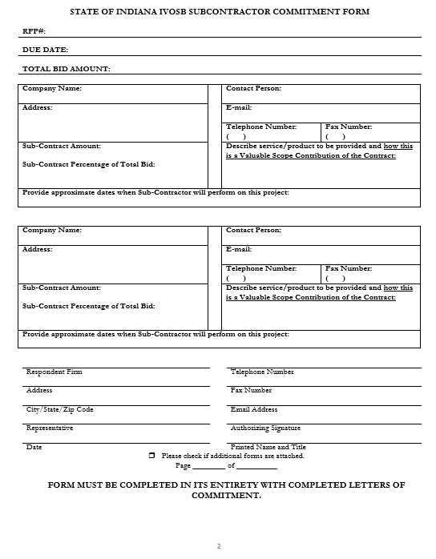
Indiana Department of Administration

Slide 26
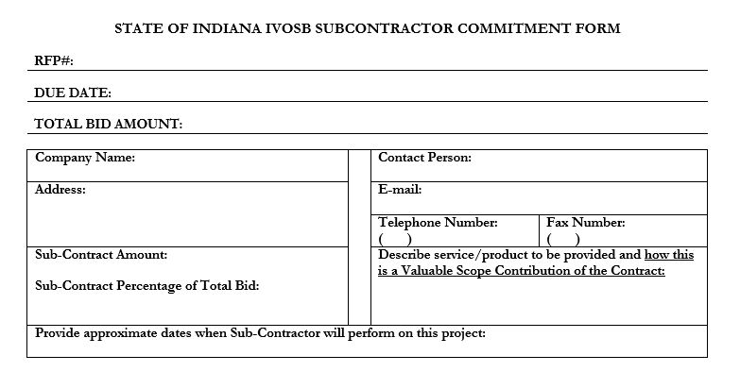
Indiana Veteran Owned Small Business
Indiana Department of Administration

Slide 27
Indiana Veteran Owned Small Business
New Process - IVOSB scoring is conducted based on 5 points plus a possible 1 bonus point scale
- IVOSB: Possible 5 points + 1 bonus point
Professional Services Scoring Methodology:
The points will be awarded on the following schedule:
Fractional points will be awarded based upon a graduated scale between whole points. (e.g. a 0.3% commitment will receive .5 points and a 1.5% commitment will receive 2.5 points)
Submissions of 0% participation will result in a deduction of 1 point in each category
The highest submission which exceeds the goal in each category will receive 5 points (5 points plus 1 bonus point). In case of a tie both firms will receive 6 points.
% | 0% | 0.6% | 1.2% | 1.8% | 2.4% | 3%
Pts. | -1 | 1 | 2 | 3 | 4 | 5
Indiana Department of Administration

Slide 28
IDOA Subcontractor Scoring
RFP MBE/WBE/IVOSB Scoring Example
Bidder | MBE % | Pts. | WBE % | Pts. | IVOSB % | Pts. | Total Pts.
Bidder 1 | 12.0% | 5.0 | 10.0% | 6.0 | 3.5% | 6.0 | 17.00
Bidder 2 | 6.0% | 3.75 | 4.0% | 2.5 | 1.8% | 3.0 | 9.25
Bidder 3 | 8.0% | 5.0 | 8.0% | 5.0 | 3.0% | 5.0 | 15.00
Bidder 4 | 16.0% | 6.0 | 0.2% | 0.0 | 0.6% | 1.0 | 7.00
Bidder 5 | 0.0% | -1.0 | 0.0% | -1.0 | 0.0% | -1.0 | -3.00
Indiana Department of Administration

Slide 29



Subcontractor Compliance
Pay Audit System
Tool utilized to monitor the state’s diversity spend for subcontractors
Selected primes and subcontractors are required to report payments submitted or received through this web-based tool
Based on contract terms payments should be reported monthly or quarterly
Questions? Contact Division of Supplier Diversity
mwbecompliance@idoa.in.gov
www.in.gov/idoa/mwbe/payaudit.htm
Prime
Submit subcontractor actual paid invoice amounts
Payment
Pay Audit System
Submit actual payments received
Subcontractor
Indiana Department of Administration

Slide 30
Additional Information
IDOA PROCUREMENT LINKS AND NUMBERS
http://www.in.gov/idoa/2354.htm
1-877-77BUYIN (8946) For Vendor Registration Questions
http://www.in.gov/idoa/2464.htm
For Inquiries Regarding Substantial Indiana Economic Impact
http://www.in.gov/idoa/2467.htm
Link to the developing “one stop shop” for vendor registry with IDOA and Secretary of State.
B. Secretary of State of Indiana:
Can be reached at (317) 232-6576 for registration assistance. www.in.gov/sos
C. See Vendor Handbook:
Online version available at http://www.in.gov/idoa/files/vendor_handbook.doc
Minority and Women Owned Business Enterprises:
http://www.in.gov/idoa/files/Certification_List(48).xls for table of IDOA certified MBEs and WBEs. For more WBE’s information http://www.in.gov/idoa/2352.htm
Veteran Owned Small Business Program:
https://www.vip.vetbiz.gov/ for a search of certified IVOSB’s. For more IVOSB’s information http://www.in.gov/idoa/2862.htm
F. RFP posting and updates:
Go to http://www.in.gov/idoa/2354.htm (select “State of Indiana Opportunities” link)
Drag through table until you find desired RFP/RFI number on left-hand side and click the link.
Indiana Department of Administration

Slide 31
Questions
Any verbal response is not considered binding; respondents are encouraged to submit any question formally in writing if it affects the proposal that will be submitted to the state.
Indiana Department of Administration

Slide 32
Thank You
Arthur L. Sample IV
Asample@idoa.IN.gov
Indiana Department of Administration

